Slide 1
Java SE 8 Book Presentation
Chapter 14 – Debugging and Exception Handling

Slide 2
14.1 Create try catch blocks and determine how exceptions alter program flow – 14.1.1 Java exception handling
- Exception is used to manage all possible ... situations happen (e.g: A read-write file program reads content from file A and write the content to file B could possibily encounter some issues such as ...) => These issues are ... happened and therefore we call it as ... situations
– In exceptional situation, we usually want to shows to users ... or at least when the program encounter some ... situation, we should ... it peacefully not just ... => This is equivalent to designing a alternative ... for these exceptional situation.
- A possible way to fix the read-write program is to use ...
(code illustration snippet 1)
- However, there will be many ... situations happen => Equilvalent to more ... branchs => ...
– Moreover, another problem arise with this type of code, which is when users ... this file in ... => The ... where the user run the file may require the source file name to have a ... format with what we ... => We can't ...
- To solve this, Java introduces a feature called ..., this will help us to have ... types of solution:
+)
+)
+)
(code illustration snippet 2)

Slide 3
14.1 Create try catch blocks and determine how exceptions alter program flow – 14.1.1 Java exception handling
- We can see that try/catch has a mechanism that is completely ... with the if/else mechanism where if/else will check for ... first and if there are no ... situation => the code will .... However, with try/catch, they will assume that our code is ... until ... happen. When ... happen, we will do something depends on the type of ... Clearly, try/catch mechanism is much more ... and ... to use when it separates code for ... and code for ...

Slide 4
14.1 Create try catch blocks and determine how exceptions alter program flow
- 14.1.2 Fundamentals of the try/catch approach
- When we develop application, there will be 2 types of people involving with the application development (the ... and the ...). It is our responsibility to explain to the ... the ...of the program and also some ... situation that might happen when using the application.
- For example, the read-write file program, we still have to assume that there might be a chance of ... situation to happen during usage => we will let ... to ... the issue by themselve and our job is just ... the issue => this is achievable by using the ... clause
(code illustration snippet 3)
- From the user's perspective, if they use the file for their ... and they have enough ... to solve the issue => they will put their method ... command inside the ... block and their ... for the issue inside the ... block. If the user also don't know how to ... the issue => they will continue to use the ... clause to ... the error to the person who ... the method
(code illustration snippet 4)
- An exception will only be considered as "handled" when .... And if we don't know how to solve it again, we will continue to use ...
(code illustration snippet 5)
- The throw clause will ... until it is ... by someone. If it is not ... => ... will handle it (since ... can't understand the logic of our code => the only thing that ... can do is ... the program)

Slide 5
14.1 Create try catch blocks and determine how exceptions alter program flow
14.1.3 Pieces of the exception handling puzzle
- Java.lang.Throwable is ... class of all exceptions. Object of this class will ... all of the information of the ... and all related ... at the time this object is created.
- Throwable object also save the ..., which called "stack trace" and also contains other information created by ... during the creation of ...
– These informations is useful when we need to find the ... of the issue
- When exception happens, we can see that there are tons of informations were printed to the console => this is the ... that is saved in Throwable object
– Throwable has 2 subclasses, ... and ... and other sub-subclasses. Each class has its own ... <take some example about index exception, null exception>
- We can also ... these classes to represent more information we need during the exception
– Everything that is called exception, is equivalent to an object of ... class
– An important subclass of Exception class is ...
– The ... statement is used by the developer for exception. Some cases where the ... statement is useful is when a dev see that the code runs into a certain condition that makes further execution become ...
(code illustration snippet 6 – 7)
- Only object that belongs to the class ... are throwable
- There are also some situations where ... can also determine which is the suitable ... to ... exception (code illustration snippet 8)

Slide 6
14.1 Create try catch blocks and determine how exceptions alter program flow
14.1.3 Pieces of the exception handling puzzle
- Java requires us to list all ... that has possibility to be thrown by using ... clause. This directly related to the ... goal of method in Java where all ... in Java must express all of their .... Java ensures that when method encounter ..., the method must either ... the exception or ... the user about the presence of exception
(code illustration snippet 9)
- The "throws" clause method is used to ... the user about the potential exception that might ... => we do this for the user to ... the exception
– The ... statement is used for developers to ... the exception. The ... statement also comes with a ... block and an optional ... block
(code illustration snippet 10)
- Try statement is completely contrast with ... statement when "try" statement tries to ... the exception while ... tries to hide from ... the exception
– .. block is where we store our ... to solve the exception. If a code exception happen, ...
– Catch block also contain something called ... clause, which specify which ....
(code illustration snippet 11)
- There is 1 thing we need to notice is that code in ... block (if they have) will always executed, no matter what happen. JVM will execute in order ... -> ... and then the stack trace will be printed out to the console. There is only 1 situation where the ... block is not executed, that is the code in ... block and ... block forces the JVM to ... by using "System.exit()"
(code illustration snippet 12)

Slide 7
14.1 Create try catch blocks and determine how exceptions alter program flow
14.1.3 Pieces of the exception handling puzzle
- Java requires us to list all ... that has possibility to be thrown by using ... clause. This directly related to the ... goal of method in Java where all ... in Java must express all of their .... Java ensures that when method encounter ..., the method must either ... the exception or ... the user about the presence of exception
(code illustration snippet 9)
- The "throws" clause method is used to ... the user about the potential exception that might ... => we do this for the user to ... the exception
– The ... statement is used for developers to ... the exception. The ... statement also comes with a ... block and an optional ... block
(code illustration snippet 10)
- Try statement is completely contrast with ... statement when "try" statement tries to ... the exception while ... tries to hide from ... the exception
– .. block is where we store our ... to solve the exception. If a code exception happen, ...
– Catch block also contain something called ... clause, which specify which ....
(code illustration snippet 11)
- There is 1 thing we need to notice is that code in ... block (if they have) will always executed, no matter what happen. JVM will execute in order ... -> ... and then the stack trace will be printed out to the console. There is only 1 situation where the ... block is not executed, that is the code in ... block and ... block forces the JVM to ... by using "System.exit()"
(code illustration snippet 12)

Slide 8
14.2 Differentiate among checked, unchecked exceptions and Error – 14.2.1 Checked and Unchecked exception
- As we mentioned earlier, throwing exception is both ... and ... responsibility. If the client didn't know about the existance of exception => they won't be able to ...
=> the "throw" clause is designed to list all ... => therefore, allowing users to ...
– However, what happen when developer forget to list all of the exception ?, at this moment, the ... will play a role. The ... will handle these situation.
- When the method is being ..., the ... will check for any possibilities of ... being thrown. And if the ... detects any possible ... without listed on ... clause => ..
- However, not all ... are detected, only some of them that belong to a special category called ... are checked
– Other exceptions that didn't belong to ... are also called ... because the compiler didn't care ....
- ... exceptions are not required to be ... on ... clause
- To distinguish between ... and ... exception. If the exception extend ... class but not extend ... and ... class are called ... exception. Other subclasses are called ... exception

Slide 9
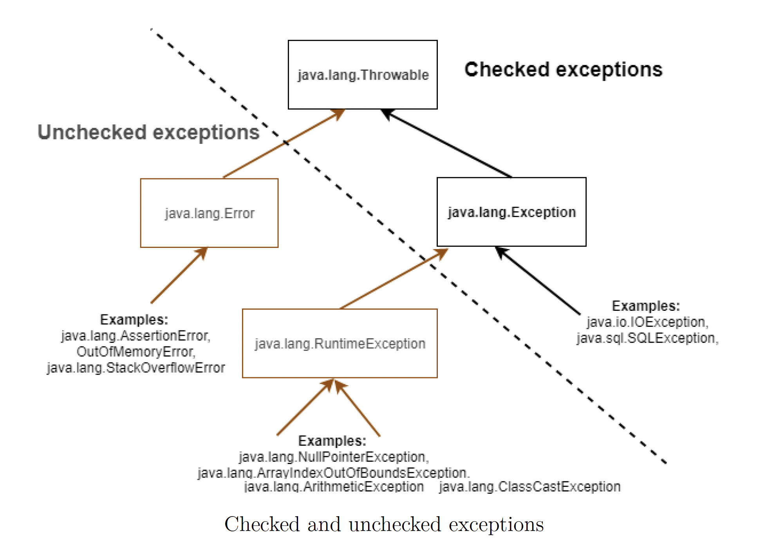
14.2 Differentiate among checked, unchecked exceptions and Error – 14.2.1 Checked and Unchecked exception
- Remember that Java designer has... exception classes => Just because it is categorized as Runtime exception doesn't mean that it is ... Or just because it is checked exception doesn't mean it is ...

Slide 10
14.2 Differentiate among checked, unchecked exceptions and Error – 14.2.1 Checked and Unchecked exception
- In the previous section, we have discussed about 2 types of exception, one that the developer ... and one that developer ...
- With the type of exception that the developer knows about it, he must ... by using .... For example, if the read-write file program can't read a file properly, the developer must design ... because these situation are still solvable => these are called checked exception
– However, with a program that requires a specific type of input, developers (and definitely ...) are expecting us to ... Or another example is the data array is null => developer ... => ... these exceptions won't help us anything since it is an indication of ... in our code => we must ... if it happens during development => But if it happens during production, we must ... at a higher level since it is related to the data that user ... into the program and we can't control this => a ... must be deployed at a higer level
- These are called unchecked exception, because the developer can't ... or it is user ...
– There are 2 types of unchecked exception, ... and ...
- Categorizing between predicted-exceptional situation and unpredicted-exceptional situation depends on the meaning of the creation of the method. For example, a method receives null parameter could ... or .... The situation where the method recieves null parameter and leads to ... are considered as ... in the code => these are called runtime exception

Slide 11
14.2 Differentiate among checked, unchecked exceptions and Error – 14.2.1 Checked and Unchecked exception
- Runtime exceptions doesn't mean that .... All exceptions are thrown at .... Runtime exceptions here indicate the type of exceptions that the developers only ... at runtime. If the developers knows about the existance of the exception before the ..., he will fix it and therefore, it won't happen again. This is the reason why ... doesn't need to be thrown because Java assume that the developer didn't ... or they have been fixed in .... time => these situation didn't require any exception to be thrown.
- For example, NullPointerException doesn't ... (because Java assumes it) and it only happens because of ... in dev's code or user ... => indication of ... in our code => instead of ... we should ... our code
– Another type of uncheck exception is ....
- Error is used only when JVM operation is ... For example, a piece of code that used up all memory, causing ... or the code that encountering endless recursion => .... Error indicates us that the interation between ... and ... has encountered a serious ...
– Error is usually thrown by ... in some extreme case => we should ... our code one error has been thrown
– Java has convention when naming exception <tell how this work>
- However, distinguish between ... exception and ... exception by looking at their name is .... <talk about what is NullPointerException, Arithmetic Exception>

Slide 12
14.2 Differentiate among checked, unchecked exceptions and Error – 14.2.2 Commonly used exception classes
- There are many exception classes, but we just need to remember some of them
ArithmeticException extends ...
(code illustration snippet 13)
IndexOutOfBoundException extends ...
(code illustration snippet 14)
NullPointerException extends ...
(code illustration snippet 15)

Slide 13
14.3 Use try and catch blocks – 14.3.1 Creating a method that throws an exception
- There is only 1 rule, if the method has a possibility of ... exception => it must be ... on ... clause
(code illustration snippet 16 – 17 - 18)
- On snippet 18, methods can still ... exception even if ... => This is considered as future-proof just in case ... => This makes sure that even if the method implementation ..., all exception is ...
(code illustration 19 – 20)
- The previous example showed us that we can use an exception class that ... all exceptions in the ... clause. However, this is ... because users will have to ... all of the possible exceptions.
- On the other hands, if the ... clause contains some exception with too ... types => It may be hard to ... the code since users has already ... the solution to ... with the exceptions that has been ... in the ... clause.
=> we must balance this without affecting the ... of the code
– For example, if we have a read file program any many exception may happen, we could ... <tell something about the exception class that cover...>

Slide 14
14.3 Use try and catch blocks – 14.3.2 Invoking a method that throws an exception
- The rule when invoking a method to ... exception is the same as creating a method that ... exception.
- Using ... statement to ... exception = invoking method ... => compiler still force us to ... the exception that the method might .... (works only with ... exception)
(code illustration snippet 21 – 22 – 23)
- Note: For the snippet 23, we can also add other Exception that could happen inside the method (that not related to the method call at all)
- Catching or throwing exception depends on whether can we ... that exception or not
(code illustration snippet 24)
- The code that we just illustrated has an error. The purpose of the catch block is to ... the solution to ... the exception and not to leave it ... to ignore the exception. Actually, ignoring the exception won't affect the execution of the code, but it will produce ... value. Normally, the "main" method don't have to ... the exception, but it has to ... the exception in the ... clause. The ... of the exception must be assigned to a proper program with GUI to ... that exception and tell the user to re-type the input
– Moreover, there will be some situation where we will need to ... the exception, even if we don't have a clear plan to solve the issue. One way to do it is print out the ... to the console for further ...
(code illustration snippet 25)

